Slide 1


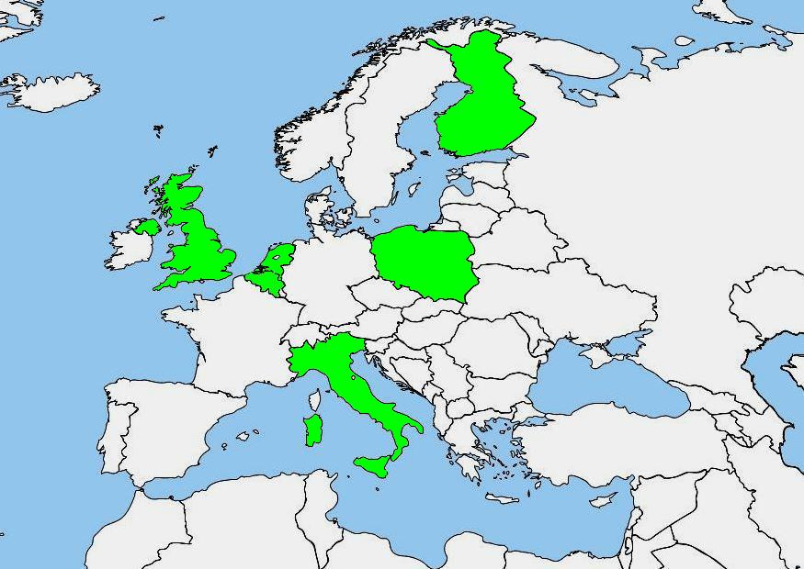



Palliative care in care homes in Europe:
EU FP7 PACE project (2014-2019)
Van den Block L, Finne-Soveri H, Gambassi G, Onwuteaka-Philipsen B, Payne S, Szczerbinska K,
Van Den Noortgate N, Vernooij-Dassen M, Deliens L on behalf of PACE
Need to better understand quality of palliative care and quality of dying in care homes in Europe
PACE is an EU-funded FP7 project studying palliative care for older people in different types of care homes in Europe (ie nursing homes, homes for older people, long term care facilities).
PACE has three substudies
Mapping palliative care structures and policies in care homes across Europe
Describing and comparing quality of care at the end of life and quality of dying in six EU countries, and exploring the structural characteristics related to better outcomes
Evaluate the effect of an innovative palliative care intervention in care homes on quality of care, quality of dying and staff competences
First results of PACE substudy 2
on quality of dying are reported
Method: cross-sectional study of deceased care homes residents in Belgium, Finland, Italy, the Netherlands, Poland and the United Kingdom
In each country, a sample of care homes representative for the country was drawn. All residents that died over a past three-month period were identified. Questionnaires with validated measures for quality of care and quality of dying were filled in by the nurse most involved in care, the GP, and a next of kin.
Deceased residents in BE, FI, NL, PL, UK
Number of people with dementia
Quality of dying measured by the EOLD-CAD (End-of-Life in Dementia Scale – Comfort while Dying) judged by the nurses
Conclusion
Variations between countries in quality of dying need to be further explored. In all countries there is room for improvement.
Higher scores
=
better quality of dying
TO KNOW MORE lvdblock@vub.ac.be| Vrije Universiteit Brussel
www.eupace.eu

